Slide 1

Introduction to Digital Listo

Slide 2
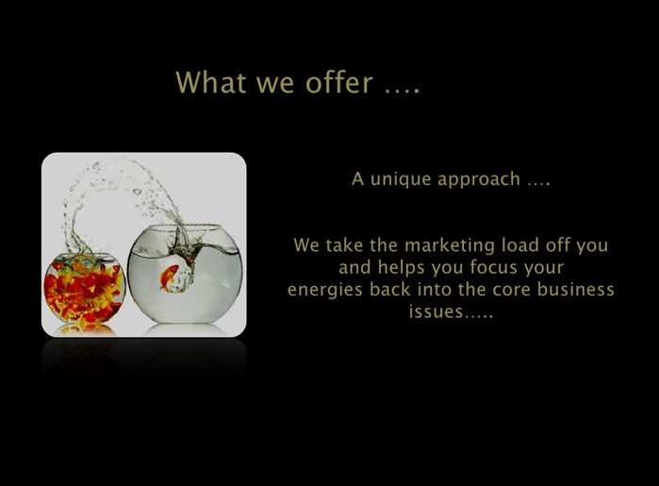


Slide 3
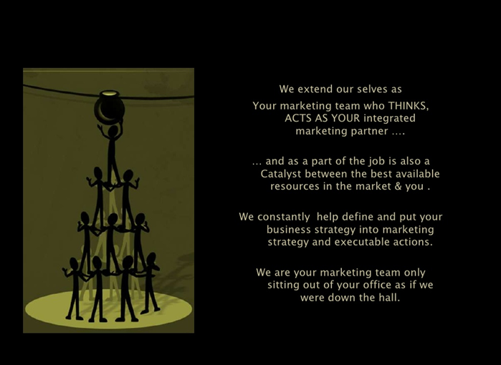


Slide 4

We take complete responsibility for all your:
Marketing/corporate/branding/communication needs.
MICI (Market Intelligence & Competitive Intelligence)
Creating Value Proposition
Strategy formulation and implementation
Planning and management
Working with advertising, public relations, direct marketing, internal communications, digital marketing....even media buying, print and production.

Slide 5
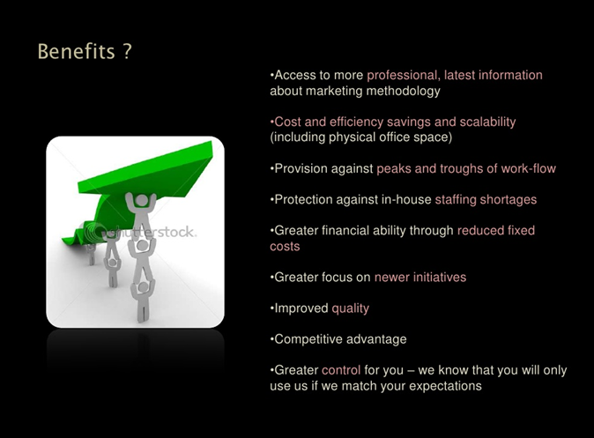


Slide 6










Our happy customers
Logo Design
Website,
e-mail marketing
Training
Website, Logo, e-mail marketing
e-mail Marketing
E-mail marketing and Outsourcing
E-mail Marketing
E-mail marketing
Training

Slide 7

Who are we?

Slide 8
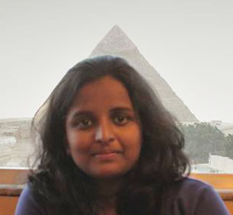
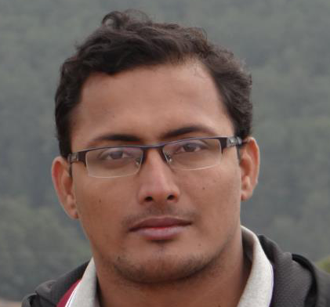
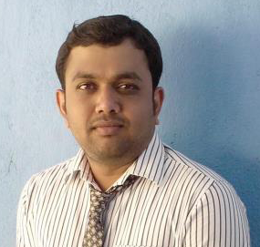
Co-founder: Neha M Changappa
Completing final year engineering and flying to NYC for Masters
Enjoys marketing, loves travelling, hacking and photography
Know more: https://in.linkedin.com/in/neha-m-changappa-6b3752101
Co-founder: Ramesh V
UK returned entrepreneur, technical architect
Worked for IBM, ExactTarget (UK)
Co-founder: Sudharshan M K
Passionate digital marketer and web developer
Worked for Infosys, Medseek USA, ExactTarget and currently with Sogeti USA on SFMC as a consultant
Know more: https://in.linkedin.com/in/msudharshan

Slide 9

We thank you for your time and look forward to work with you.
Feel free to reach out to us:
contact@digitallisto.com
+91 9686912616

